Slide 1
It's a poll not an election! Analysis of metagenomes and metatranscriptomes using probabilistic compositional approaches
🐯
🐞
👽
Greg Gloor
Department of Biochemistry
University of Western Ontario
https://github.com/ggloor/compositions/presentations
Notes:
Datasets collected by high-throughput sequencing of amplicons, or shotgun sequencing of metagenomes or metatranscriptomes are commonplace. These datasets are used to study human health and disease, ecological niches, and the built environment. Datasets collected in this way are limited by the capacity of the machine and so are necessarily probabilistic samples of the underlying environment. However, many investigators are either unaware of this or assume specific properties of the data that confound the analyses. This confounding leads to both false positive and false negative results. I will introduce the concept of probabilistic sampling and of compositional data and describe their properites and pathologies. I will provide examples from vaginal meta-transcriptomes and gut metagenomes that demonstrate the general utility of the approach. I will finally give guidance and point to resources and examples for the analysis of microbiome datasets using compositional data analysis.

Slide 2
BV dataset
🐯
🐞
👽
What assumptions do not fit?
Counts
Majority invariant
Dispersion ~ abundance
Data are centred
Model as NB or ZIG
zero == zero
Notes:
Breaks the assumptions
Note the midpoint of the dataset is off the 0 line

Slide 3
Why sequence meta-*omes
Fame? 🏆
Money? 💰
Ennui? 👻
Curiosity? 🧠
🐯
🐞
👽

Slide 4
Why sequence meta-*omes
Fame? 🏆
Money? 💰
Ennui ? 👻
Curiosity? 🧠
I hope it is because we want to understand the environment
🐙🦑🦐🦀🐡🐋🦈 vs 🐇🦌🐀🐿🦔🦒
🐯
🐞
👽

Slide 5
Sequencing is random sampling
🐯
🐞
👽
Notes:
Starting with a of molecules composed of Tigers and Ladybugs
We take a random sample, how many Tigers and how many Ladybugs
If we count a given random area we can infer how many off each there are in entire set

Slide 6
Sequencing is random sampling
🐯
🐞
👽
Notes:
Starting with a of molecules composed of Tigers and Ladybugs
We take a random sample, how many Tigers and how many Ladybugs
If we count a given random area we can infer how many off each there are in entire set

Slide 7
The sequencing meat grinder
🐯
🐞
👽

Slide 8
The sequencing meat grinder
🐯
🐞
👽
What assumptions do not fit?
Counts
Majority invariant
Dispersion ~ abundance
Model as NB or ZIG
Correlation

Slide 9
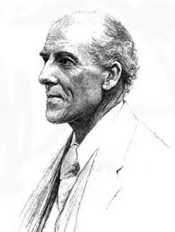
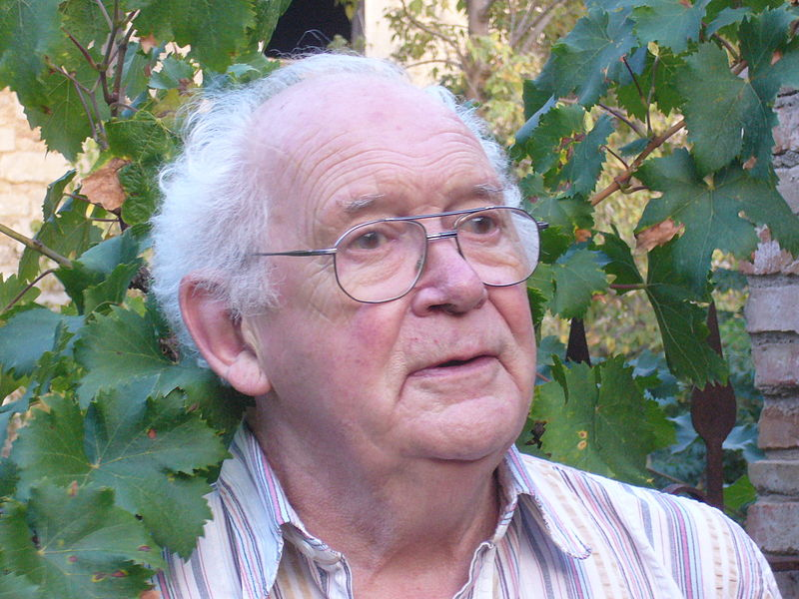
We have CoDa
🐯
🐞
👽
Compositional data are logically inconsistent with most tools in common use (Pearson 1897)
correlation, PCA etc.
Sequencing, negative binomial, rarefaction, ZIG
Work in log ratios
Aitchison and others
Conceptually similar to qPCR
Aitchison 1986

Slide 10
Random data as counts
🐯
🐞
👽
Example 100 random sample sets
range=1800-2200
range= 8000-12000
range=450-550
🐯
🐞
👽

Slide 11
Same random data as proportions
🐯
🐞
👽
Constant sum of 1000
Constant sum operations:
Sequencing
percentage, relative abundance, probability, proportion
Count normalization
Rarefaction
Gloor, et al. 2016. Ann Epidemiology
Gloor, et al. 2016. Can J. Micro.
Gloor, et al, 2017. Front. Micro.

Slide 12
CoDa properties and *lr
Count
Sequencing
Simplex
🐯
🐞
👽
27
853
66
740
112
216
Simplex: one fewer dimensions than variables
Problems remain regardless of dimension
*lr(x) = [ log(x₁/g_{X}), log(x₂/g_{X}), … log(x_{D}/g_{X}) ]
X = [ x₁, x₂, … x_{D} ], g_{X} = geometric mean of X (or subset)
Probabilities
Some invariant
Relative values
Multivariate Poisson
Aitchison 1986. Stat. Anal. Comp Data
Pawlowsky-Glahn, 2015. Mod. Anal. CoDa
Notes:
Scale dependence - hence ‘normalization’
Correlation and covariation are unreliable
Addition and subtraction are not useful operations
Subsetting and aggregating are problematic
Sparse data is an issue

Slide 13
Normalization is no help at all
🐯
🐞
👽
Once data are on the simplex, they cannot be recovered without
⌛️ 💲 🏋🏼‍

Slide 14
Correlation in CoDa
spurious correlation
Correlation observed is not the same for the numerical and proportional data
or for a subset of that data
Whenever any two variables share a common index (or have a constant sum). (Pearson 1897)
Correlation in these data must maintain a constant ratio
Pearson correlation with an intercept of 0 (RA), or linear line with a slope of 1 (log-ratio) (Lovell 2015, Erb 2017)
🐯
🐞
👽

Slide 15
Learn to love (tolerate) the simplex
 | T | A | L
x1 | 10 | 20 | 70
x2 | 20 | 10 | 70
x3 | 30 | 40 | 30
x4 | 40 | 30 | 30
🐯
🐞
👽
👽
S scale invariant
P perturbation invariant
D subcompositionally dominant
Operations
Addition: 50% + 50%
Subtraction: 50% - 50%?
Perturbation: 50% x 50% = ?
Powering: 50%^3 = ?
🐞
🐯

Slide 16
Learn to love (tolerate) the simplex
 | T | A | L
x1 | 10 | 10 | 70
x2 | 20 | 10 | 70
x3 | 30 | 40 | 30
x4 | 40 | 30 | 30
🐯
🐞
👽
👽
S scale invariant
P perturbation invariant
D subcompositionally dominant
Operations
Why not 50% - 50%?
Perturbation: 50% x 50% = ?
Powering: 50%^3 = ?
🐞
🐯

Slide 17
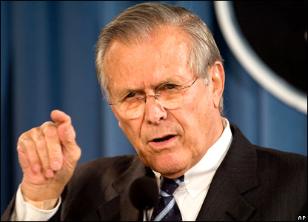
To sum up
🐯
🐞
👽
There are known knowns. These are things we know that we know.
There are known unknowns. That is to say, there are things that we know we don't know.
But there are also unknown unknowns. There are things we don't know we don't know.
There are unknown knowns. These are things we think we know that we actually don’t know.

Slide 18
What can we learn using CoDa?
Large cohort of self-reported healthy Chinese
Age-based groups from preschool to centenarians
16S rRNA gene sequencing (V4)
Fully compositional exploration
Bian et al The Gut Microbiota of Healthy Aged Chinese Is
Similar to That of the Healthy YoungmSphere: PMC5615133

Slide 19
All vs Different OTUs
ALL Features
‘SIG’Features

Slide 20
Common vs. rare OTUs

Slide 21
Common vs. rare OTUs
Results are stable to OTU subsetting and
reflect properties of the entire composition
of the samples
- Not driven by abundance or prevalence

Slide 22
Compositionally associated taxa

Slide 23
Different taxa by effect size

Slide 24
The results are stable and consistent
In a large Chinese cohort that is generally healthy
Not much changes relative to the whole
Differences are subtle
Results are stable to subsetting and other manipulations
Each method—Ordination, correlation, differential (relative) abundance—gives a similar and consistent answer
Answer is directly relatable to the relative abundances in the environment—but not to the absolute abundances
Bian et al The Gut Microbiota of Healthy Aged Chinese Is
Similar to That of the Healthy YoungmSphere: PMC5615133

Slide 25
Meta-transcriptomics of ecosystem
Information about what is being made now
Often unbalanced
Different conditions can have different taxonomic compositions
Both absolute and relative abundance of the taxa and their transcripts can change
Relative abundance does not necessarily reflect environmental reality in 16S rRNA gene sequencing or metagenomic sequencing
🐯
🐞
👽

Slide 26
Bacterial vaginosis
Most common vaginal dysbiosis
H is predominantly Lactobacillus sp.
BV is mixed bag of anaerobes with L. iners
Marked asymmetry in composition
Group genes to functional level (SEED, KEGG)
Sparse
If everything is different, then nothing is important
We must assume something is invariant
🐯
🐞
👽

Slide 27
BV dataset
🐯
🐞
👽
What is invariant here?
How do we centre?
What is truly different?
Notes:
Breaks the assumptions
Note the midpoint of the dataset is off the 0 line

Slide 28
ALDEx2: Find test values not affected by random sampling
Generate posterior estimates of the data consistent with the observed data and the chosen prior(s)
Dirichlet instances
*lr transform instances
Calculate univariate test values on each instance
Correct for FDR
Report the expected value of each test across instances
Dramatically reduces false positives with little or no loss of sensitivity for essentially any seq*omics dataset
🐯
🐞
👽
Group 1 Group 2
Fernandes, et al. 2013. PLoS ONE
Fernandes, et al. 2014. Microbiome
Thorsen et al. 2016 Microbiome
Quinn et al. 2018 Bioinformatics
Notes:
Many more fragments than we can count

Slide 29
Big Picture
🐯
🐞
👽
Macklaim, Macmillan unpublished
Macmillan Sic Rep 2015

Slide 30
Reference sequence
🐯
🐞
👽

Slide 31
Reference sequence - BV
🐯
🐞
👽

Slide 32
Functions
Denom
Cell division protein MraZ
D-tyrosyl-tRNA(Tyr) deacylase
Deoxyuridine 5'-triphosphate nucleotidohydrolase (EC 3.6.1.23)
DNA ligase (EC 6.5.1.2)
FIGfam135315: Iojap-related protein
LSU ribosomal protein L3p (L3e)
Membrane-associated zinc metalloprotease
Peptide chain release factor 3
Ribosomal large subunit pseudouridine synthase B (EC 4.2.1.70)
Signal peptidase I (EC 3.4.21.89)
Transcription-repair coupling factor
Translation elongation factor Ts
tRNA nucleotidyltransferase (EC 2.7.7.21) (EC 2.7.7.25)
Tryptophanyl-tRNA synthetase (EC 6.1.1.2)
🐯
🐞
👽

Slide 33
Four groups of functions
🐯
🐞
👽
BV
core
Core = housekeeping
BV = biosynthesis/TCA
H = aa/sugar
BV1 = …
H
BV-1

Slide 34
Distinguishing functions
🐯
🐞
👽

Slide 35
What is different between BV1 and BV2?
🐯
🐞
👽
BV2
3-keto-L-gulonate 6-phosphate decarboxylase
Carbon storage regulator
Catabolite repression HPr-like protein Crh
Chemotaxis protein CheC -- inhibitor of MCP methylation
Chemotaxis protein CheD
Chemotaxis protein CheV (EC 2.7.3.-)
Chemotaxis protein methyltransferase CheR (EC 2.1.1.80)
Chemotaxis response regulator …-glutamate methylesterase CheB (EC 3.1.1.61)
Flagellar basal-body rod protein FlgB
Flagellar basal-body rod protein FlgC
Flagellar basal-body rod protein FlgF
Flagellar basal-body rod protein FlgG
Flagellar biosynthesis protein FliS
Flagellar hook protein FlgE
Flagellar hook-associated protein FlgK
Flagellar motor rotation protein MotA
Flagellar motor rotation protein MotB
Flagellar motor switch protein FliG
Flagellar motor switch protein FliM
Flagellar motor switch protein FliN
Flagellar protein FliJ
Flagellin protein FlaB
Glucosamine-1-phosphate N-acetyltransferase (EC 2.3.1.157)
GTP-sensing transcriptional pleiotropic repressor codY
Iron-sulfur cluster assembly scaffold protein IscU
Negative regulator of flagellin synthesis
Ornithine carbamoyltransferase (EC 2.1.3.3)
Positive regulator of CheA protein activity (CheW)
Protein export cytoplasm protein SecA ATPase RNA helicase (TC 3.A.5.1.1)
Pyridoxine biosynthesis glutamine amidotransferase, synthase (EC 2.4.2.-)
Pyrophosphate-energized proton pump (EC 3.6.1.1)
Serine phosphatase RsbU, regulator of sigma subunit
Serine-protein kinase rsbW (EC 2.7.11.1)
Signal transduction histidine kinase CheA (EC 2.7.3.-)
spore peptidoglycan hydrolase (N-acetylglucosaminidase) (EC 3.2.1.-)
Substrate-specific component ThiT of thiamin ECF transporter
Thiol peroxidase, Tpx-type (EC 1.11.1.15)
BV1

Slide 36
Summary of meta-transcriptome
These data are very messy
Yet something must be assumed invariant
16s rRNA frequencies and transcriptional contribution can differ widely
Not a 16s rDNA count problem
Obviously imputing function from 16s rRNA proportions is fraught
Useful information available at the gene-level and function-level analysis
Different strains of the same species can have very different transcriptional profiles
Probably different classes of BV depending on community composition
May have implications for care

Slide 37
Examine variance of the ratios between features
Examine variance not abundance
Easily interpret relationships between samples and features
Robust to perturbations
Exploratory data analysis
Differential abundance
Compositional association
🐯
🐞
👽
Notes:
Compositional data is analyzed based on the variance of the ratios between parts. Regardless of the approach the first step is to replace 0 values prior to clr transformation. This is an open problem, but the best current approaches incorporate Bayesian estimation. I am developing CoDaSeq, an integrated toolkit that adapts the tools used for compositional data analysis in other domains to the analysis if HTS. With these tools we can find outliers, perform exploratory data analysis, examine differential abundance and find associated variables. The toolkit is applicable to many different HTS designs including transcriptome, metagenome and 16S rRNA gene sequencing. The latter will be used as an esample, since these data are the least tractable to the CoDa approach

Slide 38
Available tools
🐯
🐞
👽
Outliers & filters
CoDaSeq (github.com/ggloor)
Exploratory data analysis
Compositional biplots (compostions - CRAN)
omicplotR (Dan Giguere: github.com/dgiguer/omicplotR/wiki)
philr (Bioconductor)
Differential abundance
ALDEx2 (Bioconductor)
selbal (github.com/UVic-omics/selbal)
ANCOM (QIIME)
Compositional association
propr (CRAN)

Slide 39
Summary
🐯
🐞
👽
Analysis | Standard (count) | CoDa/probability
Beta Diversity/Ordination | Driven by most abundant taxon or gene | Variance of ratios between taxa or genes
Clustering/Ordination | Driven by most abundant taxon or gene | Variance of ratios between taxa or genes
Differential abundance | Often rare taxon or gene – most variable within and between groups | Variance of ratios between taxa or genes –most variable between groups
Correlation | Just wrong – many false positives | Pairs of taxa or genes that have common variance
Interpretation | Seems simple but is not | Seems hard but is not

Slide 40

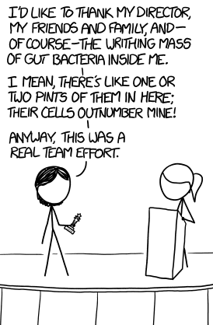


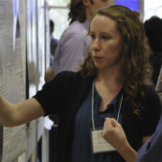



Acknowledgments
🐯
🐞
👽
Andrew
Fernandes
Jean
Macklaim
Vera Pawlowsky-Glahn
Juan Jose Egozcue
Justin Silverman
philr
Tom Quinn
propr
🐯
🐞
👽
Gregor Reid
Jeremy Burton
Amy McMillan
Daniel Giguere
Jia Rong Wu
Notes:
Many more fragments than we can count

Slide 41
Back to Bacterial vaginosis
H is predominantly Lactobacillus sp.
BV is mixed bag of anaerobes with L. iners
Marked asymmetry in composition
We must assume something is invariant
Exploratory biplots
Differential abundance
🐯
🐞
👽

Slide 42
What ratio?
X = [ x₁, x₂, … x_{D} ], g_{X} = geometric mean of X (majority invariant)
*lr(x) = [ log(x₁/g_{X}), log(x₂/g_{X}), … log(x_{D}/g_{X}) ]
IQlr(x) = [ log(x₁/I_{X}), log(x₂/I_{X}), … log(x_{D}/I_{X}) ]
IQx = geometric mean of features between q2-q3 in variance, intersect group
NZlr(x) = [ log(x₁/NZ_{X}), log(x₂/NZ_{X}), … log(x_{D}/NZ_{X}) ]
NZx = geometric mean of non-0, per group
LVlr(x) = [ log(x₁/N_{X}), log(x₂/N_{X}), … log(x_{D}/N_{X}) ]
LVx = geometric mean of low variance, high abundance, intersect per group
Ulr(x) = [ log(x₁/U_{X}), log(x₂/U_{X}), … log(x_{D}/U_{X}) ]
Ux = geometric mean of user-defined (housekeeping) features
Probabilities
Some invariant
Relative values
Multivariate Poisson
🐯
🐞
👽

Slide 43
Metabolome - subset
GC-MS
NMR
🐯
🐞
👽

Slide 44
P-values are not reliable
🐯
🐞
👽
Yeast transcriptome dataset
48 replicates, 2 conditions
Randomly choose n replicates
Calculate P and corrected P (q)
‘Truth’ is q < 0.05 of 48 replicates
Halsey, Nature Meth. 2015

Slide 45
Effect sizes are (more) stable estimates
🐯
🐞
👽
E >= 1
E >= 2
Halsey, Nature Meth. 2015

Slide 46
Multivariate and univariate methods often disagree
Multivariate group differences driven by the most abundant features in the groups
Distance/dissimilarity metrics sensitive to abundance, read depth, subsetting, other confounders (Lozupone AEM 2005, Gorvitovskaia Microbiome 2016, Wong PLoS ONE 2016)
Between group univariate differences are usually the rarest
FP rates driven by sparsity (Thorsen Microbiome 2016)
FP rates not grounded in reality (Hawindel Brief Bioinfo 2017)
🐯
🐞
👽

Slide 47
The 0 in the room
Probabilities
Some invariant
Relative values
Multivariate Poisson
0 count can be real – or a non-detect
0 count is often not 0 probability to detect the count
Sequencing instruments deliver scaled probabilities
X=[x₁,x₂,x_{i} … x_{D}] = [p₁,p₂,p_{i} … p_{D}]α ; α=ΣX; ΣP=1
x_{i} = ( P_{i} | 𝑓_{i} )α
🐯
🐞
👽
Fernandes, PLoS ONE 2013
Gloor, Aus J. Stat. 2016

Slide 48
ALDEx2
p_{i} = 0 is strong, invalid, assumption
[P_{i} > 0, P_{i} →0]
Generate a Bayesian posterior distribution of probabilities for each count in each sample; *lr transform the distribution; perform analyses on each element in the distribution; report expected values
Probabilities
Some invariant
Relative values
Multivariate Poisson
🐯
🐞
👽
Fernandes, PLoS ONE 2013
Gloor, Aus J. Stat. 2016

Slide 49
Normalizations don’t cut it by themselves (Simulated 4 feature dataset)
What we want to explore
What we have
Normalized counts
CLR transformed

Slide 50
But my data are not affected …
Transcriptome
Remove rRNA, tRNA, snRNA, etc.
Or only mRNA, snRNA, tRNA, etc.
Different amounts of RNA in the system
Marker gene sequencing
Primer bias
Remove low-counts, singletons, sparsity, chimeras, etc.
Total bacterial load varies
Asymmetry of occurrence
Metagenome
Total bacterial load varies
DNA isolation bias
Asymmetry of occurrence
🐯
🐞
👽

Slide 51
Correlation is a ‘uge problem
Numerical correlation is independent of number of features
Proportional correlation depends on other features
Spurious correlation, subcompositional incoherence

Slide 52
Must measure constant ratio

Slide 53
Where is the noise?
Variance vs. mean for data on the simplex
Transcriptome datset
Top shows absolute data, with near linear dependence
Modeled by negative binomial
Lowest and highest counts have least variance
0 is 0!
Inflates statistical significance at low count margin
Bottom shows relative data, non-linear dependence on ratios
Follows approximate Dirichlet
Lowest and highest counts have least variance, but 0 is 0!
Inflates statistical significance at low count margin
🐯
🐞
👽
Fernandes, et al. 2013. PLoS ONE
Gloor et al. 2016. Aus. J. Statistics

Slide 54
Bayesian estimate
Variance vs. mean for data on the simplex
Top shows point estimate
Follows approximate Dirichlet
Lowest and highest counts have least variance, but 0 is 0!
Inflates statistical significance at low count margin
Bottom shows Bayesian estimate
Probabilities not counts
Drawn from Dirichlet (MVP)
Values replaced by estimated probability of observing variable given total
Highest counts have least relative variance
Low counts must be very different to be significant at low count margin
🐯
🐞
👽

Slide 55
Modeling technical variation
🐯
🐞
👽
Distribution of values in replicate B for replicate A values
Transcriptome dataset
True technical variation in black
Inferred technical variation in red
Gloor et al. 2016. Aus. J. Statistics

Slide 56
Effect-sizes
🐯
🐞
👽
E=Difference/Dispersion
SELEX dataset
Convenient way to summarize univariate differences in multivariate data
X axis - maximum variation within either group for each feature
Y axis – Difference between groups for each feature
Lines indicate effect size boundaries
D=1, V=2 E=0.5
D=1 V=0.5 E=2
D=2 V=2 E=1
Read the plot in sectors
Most 16S rRNA sequencing experiments have E < 1
Transcriptome experiments E > 2
Gloor et al. 2016. J. Comp. Graph. Stat.
Notes:
Many more fragments than we can count

